Slide 1
Forests
Definition: A forest is a set of n ≥ 0 disjoint trees.
When we remove a root from a tree, we’ll get a forest. E.g., Removing the root of a binary tree will get a forest of two trees.

Slide 2
Forests
E
G
A
B
C
D
H
I
F
Figure 5.34 Three-tree forest

Slide 3
Transforming A Forest Into A Binary Tree
Definition: If T₁, …, T_{n} is a forest of trees, then the binary tree corresponding to this forest, denoted by B(T₁, …, T_{n}),
  is empty if n = 0
  has root equal to root (T₁); has left subtree equal to B(T₁₁, T_{12,}…, T_{1m}), where T₁₁, T_{12,}…, T_{1m} are the subtrees of root (T₁); and has right subtree B(T₂, …, T_{n}).

Slide 4
Transforming A Forest Into A Binary Tree
A
B
E
C
F
G
D
H
Binary tree representation
of forest of Figure 5.34
I

Slide 5
Set Representation
Trees can be used to represent sets.
Disjoint set union: If S_{i} and S_{j} are two disjoint sets, then their union S_{i} ∪S_{j} = {all elements x such that x is in S_{i} or S_{j}}.
Find(i). Find the set containing element i.

Slide 6
Possible Tree Representation of Sets
0
4
2
6
7
8
1
9
3
5
S₁
S₂
S₃

Slide 7
Possible Representations of S₁ ∪S₂
0
4
6
7
8
4
0
1
9
1
9
6
7
8

Slide 8
Unions of Sets
To obtain the union of two sets, just set the parent field of one of the roots to the other root.
To figure out which set an element is belonged to, just follow its parent link to the root and then follow the pointer in the root to the set name.

Slide 9
Data Representation for S_{1,} S₂, S₃
Set
Name
Pointer
S₁
0
4
2
S₂
6
7
8
1
9
3
5
S₃

Slide 10
Array Representation
We could use an array for the set name. Or the set name can be an element at the root.
Assume set elements are numbered 0 through n-1.
i
[0]
[1]
[2]
[3]
[4]
[5]
[6]
[7]
[8]
[9]
parent
-1
4
-1
2
-1
2
0
0
0
4

Slide 11
Array Representation
class Sets {
public :
// Set operations follow
…
private :
int *parent ;
int n ; // number of set elements
} ;
Sets::Sets ( int sz = HeapSize )
{
n = sz ;
parent = new int[sz] ;
for ( int i=0 ; i<n ; i++ ) parent[i] = -1 ;
}

Slide 12
Array Representation
void Sets::SimpleUnion( int i , int j )
// Replace the disjoint sets with roots I and j , i != j with their union
{
parent[i] = j ;
}
int Sets::SimpleFind( int i )
// Find the root of the tree containing element i
{
while( parent[i] >= 0 ) i = parent[i] ;
return i ;
}

Slide 13
Union-Find Operations
For a set of n elements each in a set of its own, then the result of the union function is a degenerate tree.
The time complexity of the following union-find operation is O(n²).
  union(0, 1), union(1, 2), …, union(n-2, n-1)
  find(0), find (1), …, find(n-1)
The complexity can be improved by using weighting rule for union.

Slide 14
Degenerate Tree
Union operation
O(n)
n-1
union(0, 1), find(0)
union(1, 2), find(0)
n-2
Find operation
O(n²)
union(n-2, n-1), find(0)
0

Slide 15
Weighting Rule
Definition [Weighting rule for union(i, j)]: If the number of nodes in the tree with root i is less than the number in the tree with root j, then make j the parent of i ; otherwise make i the parent of j.

Slide 16
Trees Obtained Using The Weighting Rule
0
1
n-1
0
2
n-1
0
3
n-1
1
1
2
0
4
n-1
0
1
2
3
1
2
3
n-1

Slide 17
Union algorithm with weighting rule
void Sets::WeightedUnion( int i , int j)
// Union sets with roots i and j , i != j , using the weighting rule
// parent[i] = -count[i] and parent[j] = -count[j] .
{
int temp = parent[i] + parent[j] ;
if ( parent[i] > parent[j] ) { // i has fewer nodes
parent[i] = j ;
parent[j] = temp ;
}
else { // j has fewer nodes ( or i and j have the same number of nodes)
parent[j] = i ;
parent[i] = temp ;
}
}

Slide 18

Weighted Union
Lemma 5.5: Assume that we start with a forest of trees, each having one node. Let T be a tree with m nodes created as a result of a sequence of unions each performed using function WeightedUnion. The height of T is no greater than .
For the processing of an intermixed sequence of u – 1 unions and f find operations, the time complexity is O(u + f*log u).

Slide 19
Trees Achieving Worst-Case Bound
[-1]
[-1]
[-1]
[-1]
[-1]
[-1]
[-1]
[-1]
0
1
2
3
4
5
6
7
(a) Initial height trees
[-2]
[-2]
[-2]
[-2]
0
2
4
6
1
3
5
7
(b) Height-2 trees following union (0, 1), (2, 3), (4, 5), and (6, 7)

Slide 20
Trees Achieving Worst-Case Bound (Cont.)
[-4]
[-4]
[-8]
0
4
0
1
2
5
6
1
2
4
3
7
3
5
6
(c) Height-3 trees following union (0, 2), (4, 6)
7
(d) Height-4 trees following union (0, 4)

Slide 21
Collapsing Rule
Definition [Collapsing rule]: If j is a node on the path from i to its root and parent[i]≠ root(i), then set parent[j] to root(i).
The first run of find operation will collapse the tree. Therefore, all following find operation of the same element only goes up one link to find the root.

Slide 22
Find algorithm with collapsing rule
int Sets::CollapsingFind( int i )
// Find the root of the tree containing element
// Use the collapsing rule to collapse all nodes from i to the root
{
for ( int r = i ; parent[r]>=0 ; r=parent[r] ) ; // find root
while ( i != r ) {
int s = parent[i];
parent[i] = r ;
i = s;
}
return r ;
}

Slide 23
Collapsing Find
[-8]
[-8]
0
0
1
2
4
1
2
4
6
7
3
5
6
3
5
7
After collapsing
Before collapsing

Slide 24
Analysis of WeightedUnion and CollapsingFind
The use of collapsing rule roughly double the time for an individual find. However, it reduces the worst-case time over a sequence of finds.
Lemma 5.6 [Tarjan and Van Leeuwen]: Assume that we start with a forest of trees, each having one node. Let T(f, u) be the maximum time required to process any intermixed sequence of f finds and u unions. Assume that u ≥ n/2. Then
  k₁(n + fα(f + n, n)) ≤ T(f, u) ≤ k₂(n + fα(f + n, n))
  for some positive constants k₁ and k₂.

Slide 25
Revisit Equivalence Class
The aforementioned techniques can be applied to the equivalence class problem.
Assume initially all n polygons are in an equivalence class of their own: parent[i] = -1,
0 ≤ i < n.
  Firstly, we must determine the sets that contains i and j.
  If the two are in different set, then the two sets are to be replaced by their union.
  If the two are in the same set, then nothing need to be done since they are already in the equivalence class.
  So we need to perform two finds and at most one union.

Slide 26
Revisit Equivalence Class
If we have n polygons and m equivalence pairs, we need
  O(n) to set up the initial n-tree forest.
  2m finds
  at most min{n-1, m} unions.
If weightedUnion and CollapsingFind are used, the time complexity is O(n + m (2m, min{n-1, m})).
  This seems to slightly worse than section 4.7 (O(m+n)). But this scheme demands less space.

Slide 27
Example 5.5
[-1]
[-1]
[-1]
[-1]
[-1]
[-1]
[-1]
[-1]
[-1]
[-1]
[-1]
[-1]
0
1
2
3
4
5
6
7
8
9
10
11
(a) Initial trees
[-2]
[-2]
[-2]
[-2]
[-1]
[-1]
[-1]
[-1]
0
3
6
8
2
5
7
11
4
1
10
9
(b) Height-2 trees following 0≡4, 3≡1, 6≡10, and 8≡9

Slide 28
Example 5.5 (Cont.)
[-3]
[-4]
[-3]
[-2]
0
6
3
2
4
7
10
8
1
5
11
9
(c) Tree following 7≡4, 6≡8, 3≡5, and 2≡11

Slide 29
Example 5.5 (Cont.)
[-3]
[-4]
[-3]
0
6
3
4
7
2
10
8
1
5
11
9
(d) Tree following 11≡0

Slide 30
An Object-Oriented System of Tree Data Structures
BinaryTree
SearchStruct
MaxPQ
CompleteBinaryTree
BST
MaxHeap
Winner
Figure 5.44 Inheritance graph showing the relationship
between different ADTs

Slide 31
Class Definition of Base Classes depicted in figure 5.44
enum Boolean {FALSE, TRUE};
const int DefaultSize = 20;
class MaxPQ {
public:
virutal void Insert(const int) = 0;
virutal int* DeleteMax(int &) = 0;
};
class SearchStruct {
public:
virtual void Insert(const int) = 0; // pure virtual functions
virtual int* Delete(int&) = 0;
virtual Boolean Search(const int) = 0;
};

Slide 32
Class Definition of Base Classes depicted in figure 5.44
class BinaryTree {
public:
virtual void inorder(); // driver
BinaryTree() { root = 0 ; } ; // constructor
protected:
class BinaryTreeNode { // Nested class
public:
BinaryTreeNode *LeftChild, *RightChild;
int data;
};
BinaryTreeNode *root;
virutal void inorder(BinaryTreeNode *);
};

Slide 33
Class Definition of Derived Classes depicted in figure 5.44
class CompleteBinaryTree : public BinaryTree {
public :
virtual void inorder(); // driver
CompleteBinaryTree( int sz = DefaultSize ) : MaxSize(sz) , n(0) {
tree = new int[MaxSize+1] ;
};
protected:
int *tree , MaxSize , n ;
virtual void inorder(int) ; // hides BinaryTree::inorder(BinaryTreeNode *)
};

Slide 34
Class Definition of Derived Classes depicted in figure 5.44
class MaxHeap : public MaxPQ , public CompleteBinaryTree {
// multiple inheritance
public :
MaxHeap ( int sz = DefaultSize ) : CompleteBinaryTree(sz) {};
virtual void Insert(const int);
virtual int* DeleteMax(int&);
};
class WinnerTree : public CompleteBinaryTree {
public :
WinnerTree( int sz = DefaultSize ) : CompleteBinaryTree(sz) {} ;
} ;

Slide 35
Class Definition of Derived Classes depicted in figure 5.44
class BST : public SearchStruct , public BinaryTree {
// multiple inheritance
public :
BST() { root = 0 ;} ;
virtual void Insert( const int );
virtual int* Delete( int& );
virtual Boolean search( const int ) ;
};

Slide 36
Inorder Traversal of BinaryTree and CompleteBinaryTree
void BinaryTree::inorder() { inorder(root); }
void BinaryTree::inorder(BinaryTreeNode *CurrentNode) {
if (CurrentNode) {
inorder(CurrentNode->LeftChild);
cout << CurrentNode->data;
inorder(CurrentNode->RightChild);
}
}

Slide 37
Inorder Traversal of BinaryTree and CompleteBinaryTree
void CompleteBinaryTree::inorder() { inorder(1); }
void CompleteBinaryTree::inorder( int current ) {
if (current <= n) {
inorder(2*current);
cout << tree[current];
inorder(2*current+1);
}
}

Slide 38
Counting Binary Tree
We consider the following three disparate problems:
  The number of distinct binary trees having n nodes
  The number of distinct permutations of the numbers from 1 through n obtainable by a stack
  The number of distinct ways of multiplying n+1 matrices .
They amazingly have the same solution .

Slide 39
Distinct Binary Trees
There are 5 distinct binary tree

Slide 40
Stack permutation
In section 5.3 we introduced preorder, inorder, and postorder traversal of a binary tree and indicated that each traversal requires a stack.
Every binary tree has a unique pair of preorder/inorder sequences .
The number of distinct binary trees is equal to the number of inorder permutations obtainable from binary trees having the preorder permutation, 1 , 2 , … , n .

Slide 41
Stack permutation
So, we can show that the number of distinct permutations obtainable by passing the numbers 1 through n through a stack is equal to the number of distinct binary trees with n nodes .
Example : if we start with the numbers 1 , 2 , and 3 , then the possible permutations obtainable by a stack are
(1,2,3) (1,3,2) (2,1,3) (2,3,1) (3,2,1)

Slide 42
Stack permutation
1
1
1
1
1
2
2
2
3
2
2
3
3
3
3
(1, 2, 3)
(1, 3, 2)
(2, 1, 3)
(2, 3, 1)
(3, 2, 1)
Binary trees corresponding to five permutation

Slide 43
Matrix Multiplication
The number of distinct binary trees is equal to the number of distinct inorder permutations obtainable from binary trees having the preorder permutation, 1, 2, …, n.
Computing the product of n matrices are related to the distinct binary tree problem.
M₁ * M₂ * … * M_{n}
n = 3 (M₁ * M₂) * M₃ M₁ * (M₂ * M₃ )
n = 4 ((M₁ * M₂) * M₃) * M₄
(M₁ * (M₂ * M₃)) * M₄
M₁ * ((M₂ * M₃) * M₄ )
(M₁ * (M₂ * (M₃ * M₄ )))
((M₁ * M₂) * (M₃ * M₄ ))

Slide 44
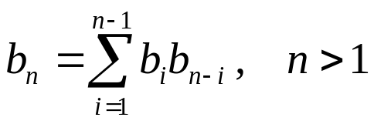
Matrix Multiplication
Let bn be the number of different ways to compute the product of n matrices. b₂ = 1, b₃ = 2, and b₄ = 5.

Slide 45

Number of Distinct Binary Trees (Cont.)
The number of distinct binary trees of n nodes is
b_{n}
b_{i}
b_{n-i-1}

Slide 46
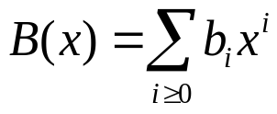
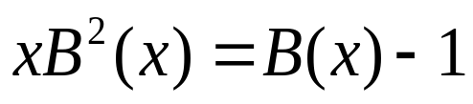
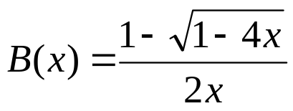
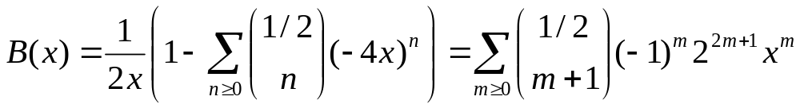
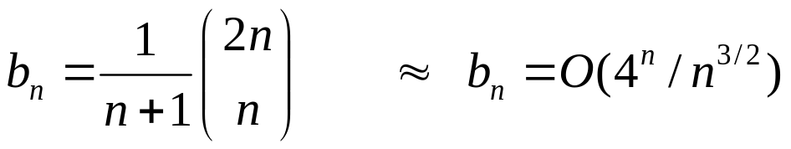
Distinct Binary Trees (Cont.)
Assume we let which is the generating function for the number of binary trees.
By the recurrence relation we get

